Slide 1
Introduction to Iterables: Lists
Session Five
Notes:
Welcome to our fifth session! Today we will be learning a new data type lists and we will be learning about loops. The coding section of this class will be dense today so know that going in. We will also have our first guest speaker - Craig Heckman.

Slide 2
Reminders
Due Today
Due Next Week
Homework from Session Four
Quiz on Session Four Content
Homework from this session
Quiz on this session’s content
Notes:
As some quick reminders before we get into things, today we’re going to have your second fully graded quiz and your homework is due.

Slide 3
Reminders
Due Today
Due Next Week
Homework from Session Four
Quiz on Session Four Content
Homework from this session
Quiz on this session’s content
Notes:
Next week you’ll have another homework due and you’ll have your third graded quiz in class.

Slide 4
Agenda / Topics
1. Start of Class & Quiz
2. List concept & Syntax
3. For Loops
4. Break
5. Guest Speaker
6. Overflow / Q&A / Dismissal
6:30 - 7:00
7:00 - 7:45
7:45 - 8:00
8:00 - 8:15
8:15 - 8:45
8:45 - 9:00
Notes:
Today we’ll have a q&a to answer any last-minute burning questions from last week and then we’ll be doing the practice quiz. After that, we’ll start the lecture. We’ll cover a handful of topics with a break at 8 pm and we’ll wrap the class up before 9 pm.

Slide 5
Follow-up on last week’s material:
PIRs & Grading

Slide 6
PIRs
There is a difference between intelligence questions and business operational questions.
The most effective way to write PIRs is to start with one high level question and then decompose that question with all of the questions underneath it which you would need to answer in order to answer the higher level question.
When you think about collection requirements and data sources be granular in identification of the data source.

Slide 7
Grades
Check Canvas for grades.
Know that the Canvas grades are not properly weighted.
Notes:
All grades will be posted on Canvas. Note that weighting will not be done so know that the total % is not accurate.

Slide 8
Q&A
?
Notes:
Any last-minute questions before the quiz?

Slide 9

Quiz
Access the quiz here: https://forms.gle/h2aQwPiPiV2M3p2u6
Screenshot before submitting & don’t refresh.
Notes:
Alright! Here’s the quiz. Please remember to screenshot or otherwise record your answers before you hit submit and don’t refresh! Google forms will drop your answers if your connection drops. Please be prepared.
https://forms.gle/h2aQwPiPiV2M3p2u6

Slide 10
CONCEPT: ITERABLES & ITERATION
Where code starts to get interesting.
Warning: This is a really heavy lecture. You’re going to be using these concepts a lot. Get ready to take meaningful notes and set aside distractions.

Slide 11
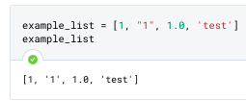
New Iterable: Lists
[ | 1 | “1” | 1.0 | ‘test’ | ... | . | ]
Index: | 0 | 1 | 2 | 3 | ... | n
Lists are an ordered set of objects. Any object can be contained in a list.
Lists start and end with square brackets.
Items in a list all have an index.
You can access an item at a given index using the same syntax as we covered with strings, e.g. [0, 1, 2][0] will give you the item in the zeroeth index (zero).
E | x | a | m | p | l | e | ... | .
0 | 1 | 2 | 3 | 4 | 5 | 6 | ... | n
NB: Strings are, under the hood, actually a type of immutable (unchangeable) list.

Slide 12
Iterables / Iteration
An iterable is an object capable of returning its members one at a time.
A string is a type of iterable. A list is another.
The act of moving through the items in an iterable is to iterate that item.
Each step through the iterable is called an iteration.
“Give me the zeroeth character.
Now give me the first character.
Now give me the second character.
…
Now give me the nth character.”
“ | E | x | a | m | p | l | e | ... | . | “
Index: | 0 | 1 | 2 | 3 | 4 | 5 | 6 | ... | n

Slide 13
Tasks for today with Iterables
Modifying Lists
Iteration
Methods that Use Lists
Puzzles
Creating lists.
Adding elements with append, extend
Changing elements with slicing
Removing elements with clear, del, pop, and remove.
Moving through an iterable using a for loop
List Comprehensions as an alternative to for loops
Using .join() to create a string from a list and .split() and .splitlines() to make lists from strings.
We now have almost all of the tools to do some challenging Python programming.

Slide 14
Tasks for today with Iterables
Modifying Lists
Iteration
Methods that Use Lists
Puzzles
Creating lists.
Adding elements with append, extend
Changing elements with slicing
Removing elements with clear, del, pop, and remove.
Moving through an iterable using a for loop
Using .join() to create a string from a list and .split() and .splitlines() to make lists from strings.
We now have almost all of the tools to do some challenging Python programming.

Slide 15
Creating Lists
Creation
Tip: Generally, if you see square brackets, you’re usually seeing someone either creating a list or accessing an element of an iterable. There are other uses - but these are the most common ones.
x = [1, 2, 3, 4]
# “x is a list of integers”
x = [‘this’, ‘is’, ‘an’, ‘example’]
# ‘x is a list of strings’
x = [1.0, 1.1, 1.2]
# x i s a list of floats
x = [True, False, 1.0, 3, ‘test’]
# ‘x is a list’ or ‘x is a list of mixed type’
x = list(“example”)
# creates a list from another compatible object
# e.g. ['e', 'x', 'a', 'm', 'p', 'l', 'e']

Slide 16
Data Types to date
Type | Examples | Properties / Description
Name: Integer Code to convert: int(x) | -1 0 1 | Integer whole numbers that you can use in mathematical operations
Name: Floating Point Code to convert: float(x) | -1.0 0.0 1.0 | Decimal-point precision real numbers that you can use in mathematical operations
Name: String Code to convert: str(x) | “Example” “1.0” | Ordered sequence of text characters, cannot be used in mathematical operations
Name: List Code to convert: list() | [1, 2, 3] [“one”, 2, False] | Ordered sequence of Python objects of any type

Slide 17
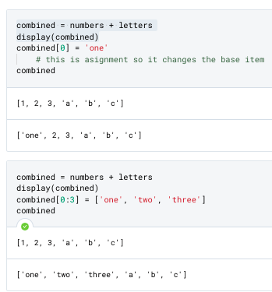
Modifying Items In Lists
You can modify the items in a list by specifying which item index or slice you want to change.
More complex modifications generally involve some form of a loop (or list comprehension).
We’ll get there later today.
Index / Slice Assignment

Slide 18
String-Specific Functions & Methods
Something important: lower and upper are both methods. We will cover these in more detail later. But for now, you should know that they modify the object they are called on. Neither of these methods changes the object they are called on permanently - but some methods we will see later will passively change their parent object.
We are going to start seeing these today.

Slide 19
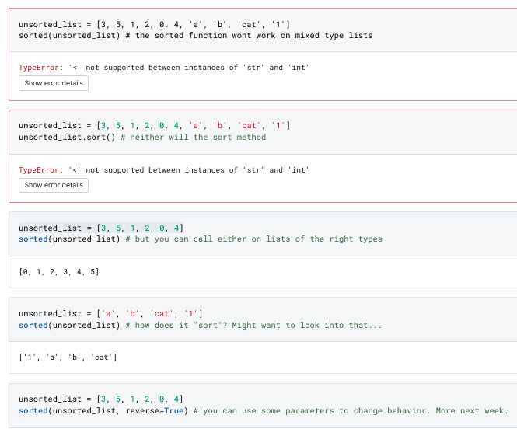
Modifying Items In Lists
Sort vs Sorted
You can sort lists using the Sorted function or the Sort method. We’ll talk more about these next week. The important things to know for now:
list.sort() is going to replace the list in place by modifying the original.
sorted() will create a new list and return it. Sorted works on some non-list objects (like strings) but will return a LIST.
There are additional parameters that you can use to modify behavior. We will cover these with more depth next week.

Slide 20
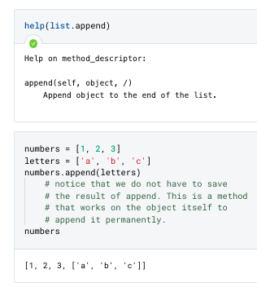
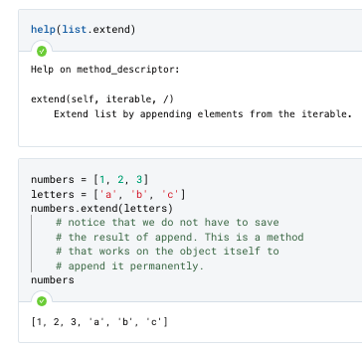
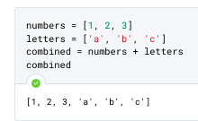
Adding items to lists: Append and Extend
APPEND
EXTEND
You can add items to a list with one of two methods: append or extend.
Important:
Append adds OBJECTS. Extend expects an ITERABLE.
extend
By default, the + operator acting on lists will do an extension.
+

Slide 21
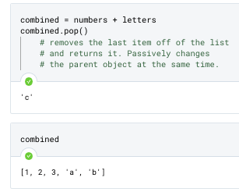
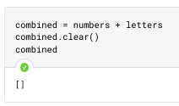
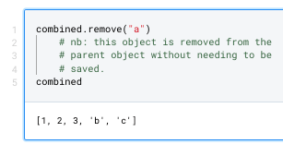
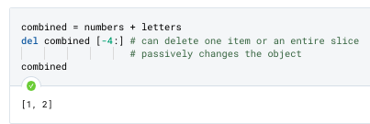
Removing Items from lists
There are several methods available for removing items from lists, depending on how you would like to specify what to remove.
Remove all items: clear()
Remove an item by index and get its value: pop()
Remove an item by value: remove()
Remove items by index or slice: del
POP
CLEAR
REMOVE
DEL

Slide 22
Tasks for today with Iterables
Modifying Lists
Iteration
Methods that Use Lists
Puzzles
Creating lists.
Adding elements with append, extend
Changing elements with slicing
Removing elements with clear, del, pop, and remove.
Moving through an iterable using a for loop
List Comprehensions as an alternative to for loops
Using .join() to create a string from a list and .split() and .splitlines() to make lists from strings.
We now have almost all of the tools to do some challenging Python programming.

Slide 23
Strings: Iterables / Iteration
An iterable is an object capable of returning its members one at a time.
A string is a type of iterable.
The act of moving through the items in an iterable is to iterate that item.
Each step through the iterable is called an iteration.
“Give me the zeroeth character.
Now give me the first character.
Now give me the second character.
…
Now give me the nth character.”
“ | E | x | a | m | p | l | e | ... | . | “
Index: | 0 | 1 | 2 | 3 | 4 | 5 | 6 | ... | n

Slide 24
Vocab / Concept Example with a string
“Iterate over the provided iterable. On each iteration, if the character is uppercase, return the character in the appropriate index”.
E | x | A | m
0 | 1 | 2 | 3
Iteration: | Index: | Value: | Decision: | Result:
1 | 0 | E | Letter is capitalized, return it | E
2 | 1 | x | Letter is lower, do not return it | (pass)
3 | 2 | A | Letter is capitalized, return it | A
4 | 3 | m | Letter is lower, do not return it | (pass)
“EA”

Slide 25
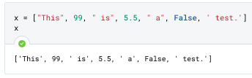
Vocab / Concept Example with a List
“This” | 99 | “ is” | 5.5 | “ a” | False | ‘ test.’
0 | 1 | 2 | 3 | 4 | 5 | 6
“Iterate over the provided iterable. On each iteration, if the value is a string, return it”.
Iteration: | Index: | Value: | Decision: | Result:
1 | 0 | “This” | String, so return it | “This”
2 | 1 | 99 | Integer, do not return | (pass)
3 | 2 | “ is” | String, so return it | “ is”
4 | 3 | 5.5 | Float, so do not return | (pass)
5 | 4 | “ a“ | String, so return it | “ a”
6 | 5 | False | Bool, do not. | (pass)
7 | 6 | ‘ test.’ | String, return it. | ‘ test.’

Slide 26
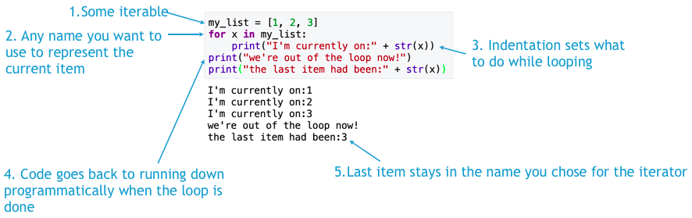
For Loops: Syntax Example
Notes:
The type of code you use to accomplish this interaction is called a “for loop”. In a for loop, you tell the code to do some interaction per each item in your iterable. Here’s the basic syntax.

Slide 27
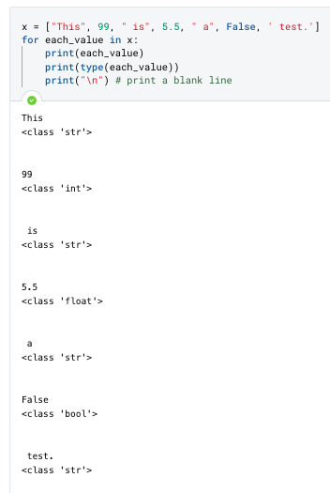
For Loops: Example with code
Goal: “Iterate over the provided iterable. On each iteration, if the value is a string, collect it and return one final string as a result”.
Pseudocode:
# First, let’s just get the for loop working
# Loop through each item in the list one at a time
# Print the item and its type

Slide 28
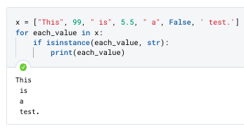
For Loops: Example with code
Goal: “Iterate over the provided iterable. On each iteration, if the value is a string, collect it and return one final string as a result”.
Pseudocode:
# Now that we have the for loop, instead of printing
# let’s check if each is a string or not with isinstance()

Slide 29
For Loops: Example with code
Goal: “Iterate over the provided iterable. On each iteration, if the value is a string, collect it and return one final string as a result”.
Now that we know we can test to see if something is a string and we know we can get all of the strings, we need to find some way to store all of our strings.
Challenge: How can we get our strings out?

Slide 30
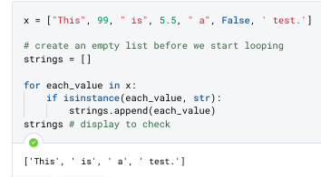
For Loops: Example with code
Goal: “Iterate over the provided iterable. On each iteration, if the value is a string, collect it and return one final string as a result”.
Now that we know we can test to see if something is a string and we know we can get all of the strings, we need to find some way to store all of our strings.
Challenge: How can we get our strings out?
Answer: Create a list to hold items outside of the loop first.
Then, as we loop, we add them to the list.
Next Challenge: Can we turn these back into one string?

Slide 31
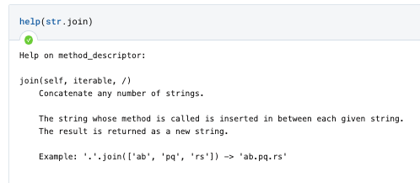
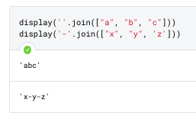
New Method: str.join()
We could use a for loop to do this. But there’s a very commonly used method called .join() that is used for just this.
Join has two parts. In the parenthesis, it takes a list of strings that you want to join together into one string. Before the dot, you need to provide a string with any characters you want added between each item in the list. If you want nothing added, it should be an empty string (‘’).

Slide 32
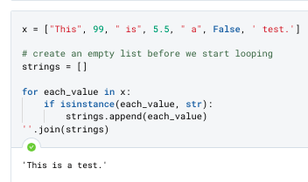
For Loops: Example with code
Goal: “Iterate over the provided iterable. On each iteration, if the value is a string, collect it and return one final string as a result”.
Using .join(), we can complete the challenge.

Slide 33
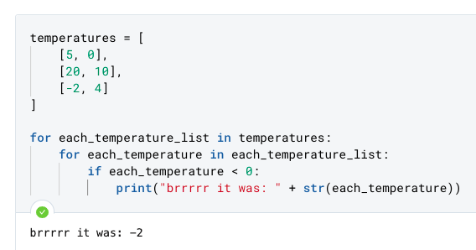
Nesting Loops
As we did with conditional statements, you can also nest loops to create complex code.

Slide 34
Tasks for today with Iterables
Modifying Lists
Iteration
Methods that Use Lists
Puzzles
Creating lists.
Adding elements with append, extend
Changing elements with slicing
Removing elements with clear, del, pop, and remove.
Moving through an iterable using a for loop
List Comprehensions as an alternative to for loops
Using .join() to create a string from a list and .split() and .splitlines() to make lists from strings.
We now have almost all of the tools to do some challenging Python programming.

Slide 35
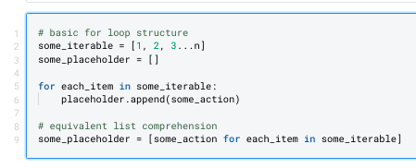
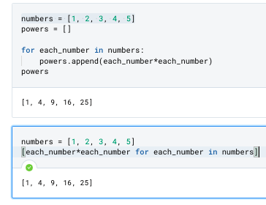
List Comprehensions
Whenever you find yourself running a for loop in which you are creating an empty list to store some result based on another list, you can probably write your code more simply as a list comprehension.
These allow you to do some action for each item in some iterable and return the results as a new (unnamed) list. The syntax is:
Generic pseudocode
Example Code: for loop
Example Code: list comprehension

Slide 36
Tasks for today with Iterables
Modifying Lists
Iteration
Methods that Use Lists
Puzzles
Creating lists.
Adding elements with append, extend
Changing elements with slicing
Removing elements with clear, del, pop, and remove.
Moving through an iterable using a for loop
List Comprehensions as an alternative to for loops
Using .join() to create a string from a list and .split() and .splitlines() to make lists from strings.
We now have almost all of the tools to do some challenging Python programming.

Slide 37
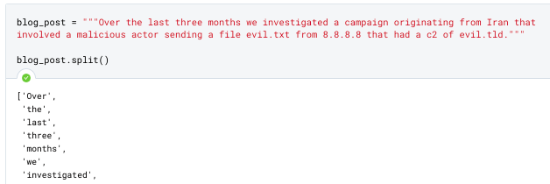
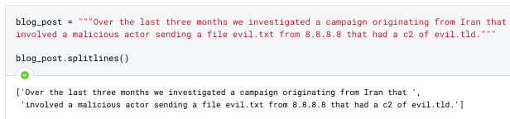
str.split() and str.splitlines()
In the security space, we do a lot of work that involves parsing text fields into concrete elements. Consider scenarios like:
“Parse this vendor blog for IOCs and then check our logs to see if we’ve seen these md5s before on our system”
“Compare our IP logs against this list of bad IPs from a partner”
For tasks like this, it’s really important to be able to change text strings into structured data (the only format we’ve learned so far is the list) so that you can do comparisons and other work.
split
TIP: By default, split splits on spaces - but you can also control what it splits on with parameters!
splitlines

Slide 38
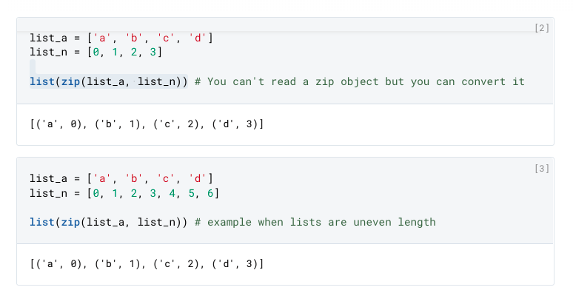
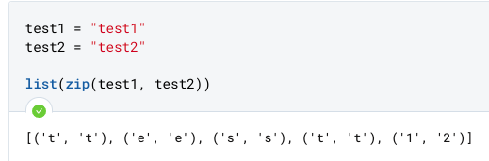
zip()
Tip: zip produces a zip type object (which you can’t inspect easily). Converting it to a list will create a list of tuples, which you can see.
You can interact with tuples like they are lists, iterating through them and getting values as needed. But they can’t be modified themselves.

Slide 39
Guest Speaker:
Craig Heckman

Slide 40
Concepts to review from this session
New Data Types Fundamental Python constructs that define how data is stored and what can be done with it. | list() Tuples (soft introduction)
New Concepts Ideas, concepts, or other abstract processes for working with code. | Iterables
New Operators Python foundational operators that take action on data. | Del
New Keywords / Expressions Reserved keywords, statements, expressions, or other constructs for manipulating data. | For Loop List Comprehension
New Functions Python’s general purpose way to call code to complete specific tasks | sorted()
New Methods Code that belongs to specific object types that can be called on objects of the appropriate type. | Strings: str.split() str.splitlines() str.join() | Lists: list.append() list.extend() list.remove() list.clear() list.pop() list.sort() zip()

